Slide 1


Analysis of content categories

Slide 2


Today's agenda
Project recap
Problem
The Analytics team
Process
Insights
Summary

Slide 3

Social Buzz has grown rapidly. Accenture is running
a 3 month initial project to meet their need.
- An audit of their big data practice
- Recommendations for a successful IPO
- An analysis of their content categories
that highlights the top 5 categories
with the largest aggregate popularity
Project Recap

Slide 4

Over 100,000 posts per day
Analysis:
Top 5 popular categories
Problem

Slide 5



Andrew Fleming
(Chief Technical Architect)
The Analytics team
Marcus Rompton
(Senior Principle)
Yishan Zhan
(Data Analyst)

Slide 6
Tool: Jupyter Notebook
Packages: numpy, pandas, seaborn, matplotlib
Process
1
2
Explore dataset
Cleaning
3
Data modeling
4
Data analysis
5
Insights

Slide 7

Insights
16 unique categories
Science
Travel
Healthy eating
Animals
Cooking
Avg 1200 Posts
In each
August
Most Posts

Slide 8
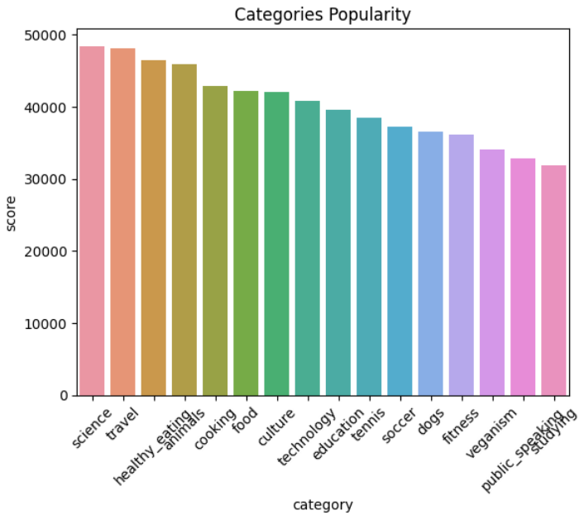

Slide 9
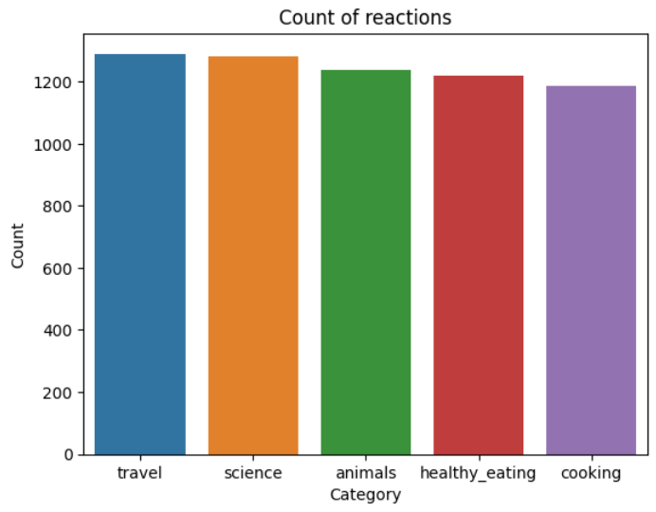

Slide 10
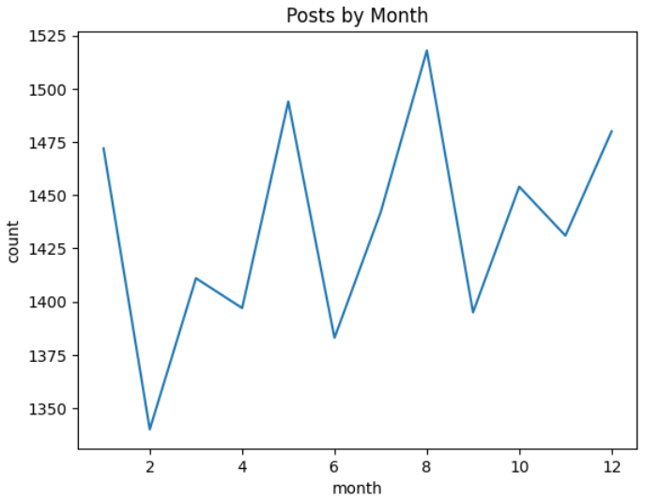

Slide 11

Science
Travel
Healthy eating
Animals
Cooking
Summary
1200 posts
August

Slide 12
Thank you!
ANY QUESTIONS?

